Slide 1
Analysis Tibias and Hips
22.08.2024

Slide 2
Preprocessing
Read samples and add metadata
Clean rows that have rowSums < than 30 counts
TIBIA
HIP
BONE = TIBIA and HIP
The number of genes after filtering the samples separately is different, making some genes having specificity to one tissue.
Rerun analysis for plots and DEG

Slide 3
Plot PCA
Tibias
Hips
Pellets/SVFs
Adipocytes

Slide 4
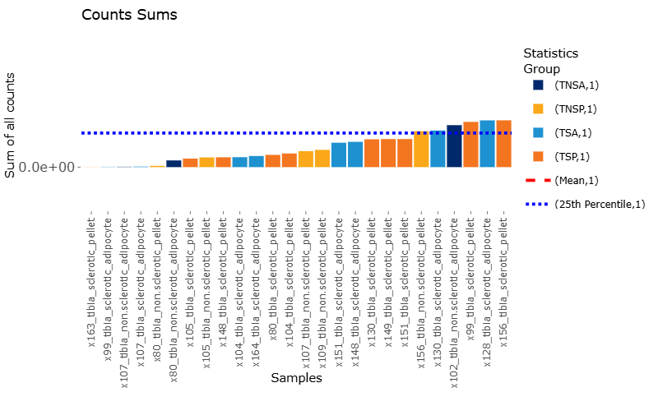
Filtered samples Tibias
Plus extra 80 and 107 as 3 were removed to avoid noise

Slide 5
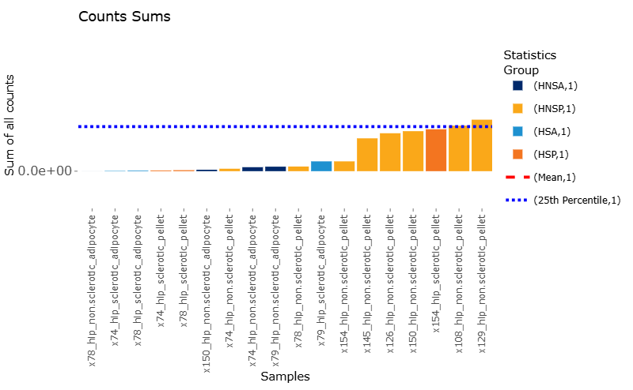
Filtered samples Hips

Slide 6
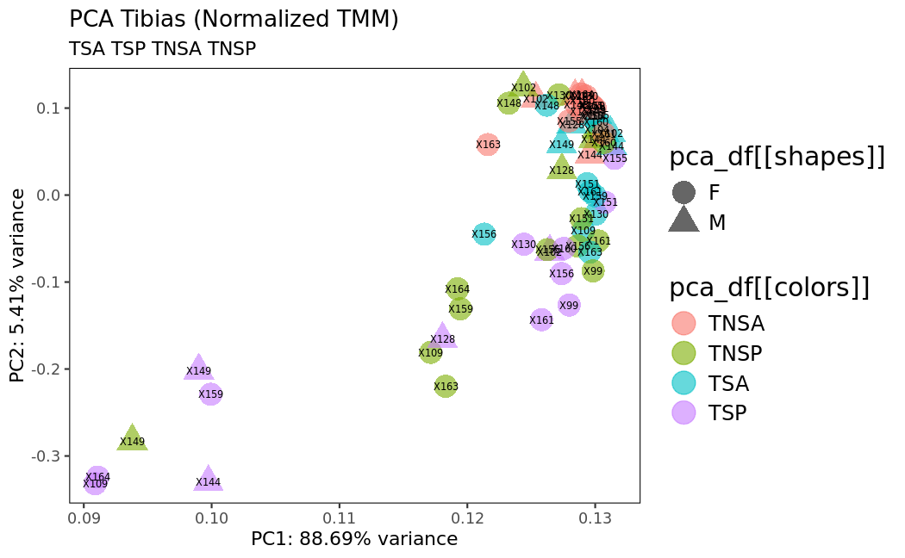
Normalized samples TIBIAS after removing samples due to low number of reads

Slide 7
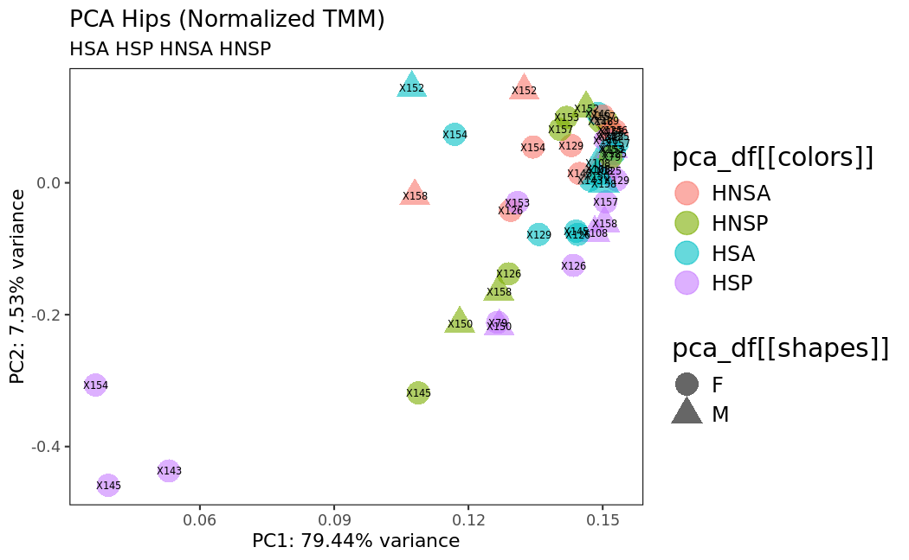
Normalized samples HIPS after removing samples due to low number of reads

Slide 8
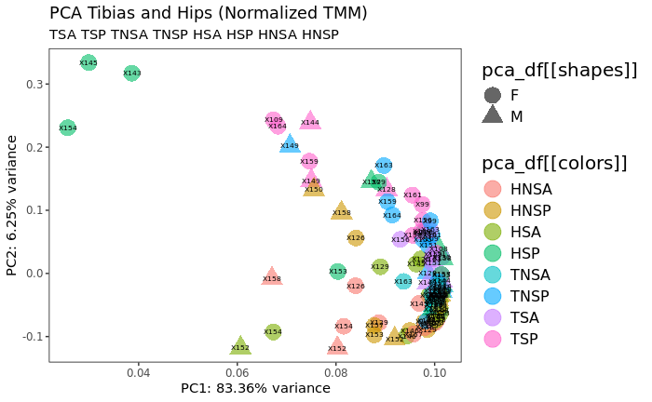
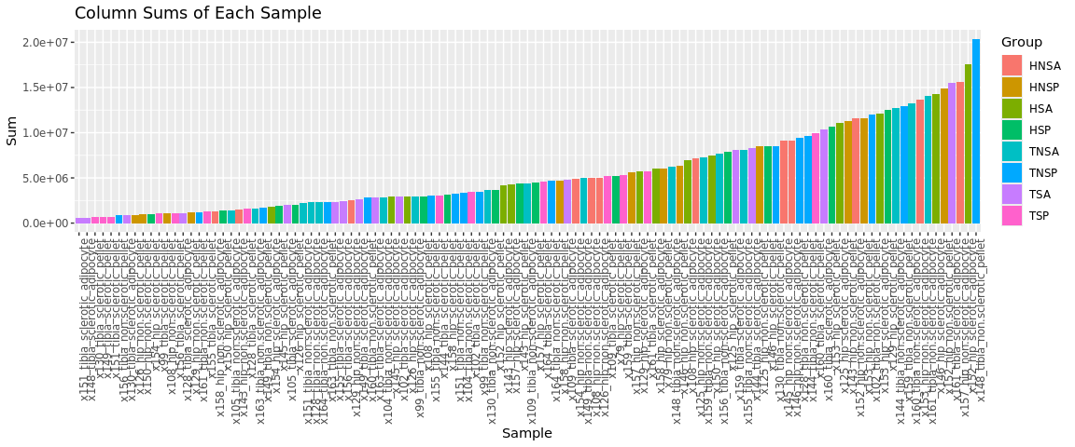
Normalized samples BONES after removing samples and selecting commong genes

Slide 9
Extra normalized plots
Find normalized PCAs for:
Tibias adipocytes
Tibias pellet
Find normaliued PCAs for:
Hips adipocytes
Hips pellet
Sclerotic and non-sclerotic
Tibias and hips together
Non sclerotic
Pellet
Adipocytes
Sclerotic
Pellet
Adipocytes

Slide 10
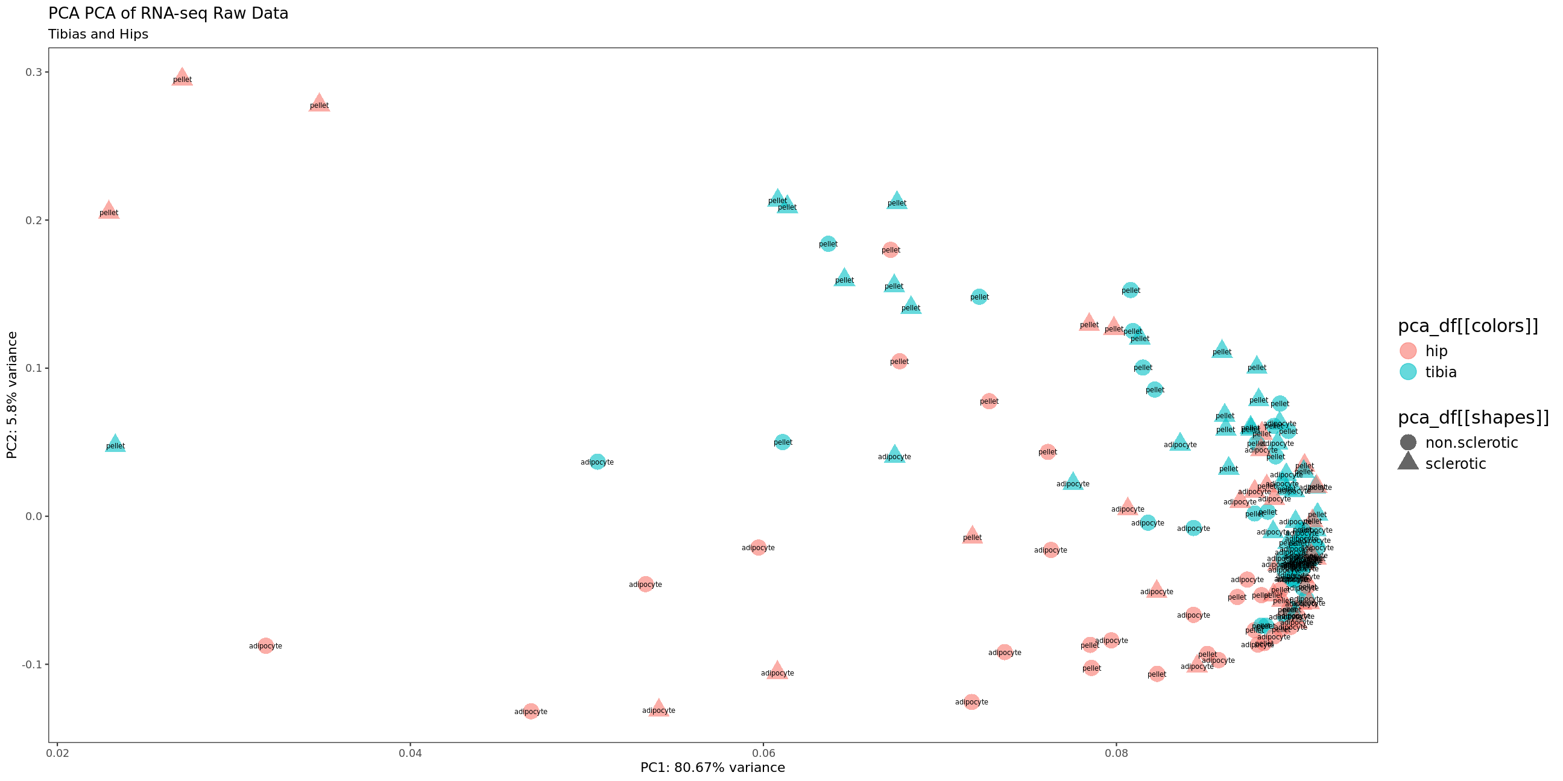

Bone (hip and tibia)

Slide 12
DEG among selected conditions
HIP
Non-Sclerotic vs Sclerotic
Adipocytes non-Sclerotic vs Sclerotic
Pellet non-Sclerotic vs Sclerotic
TIBIA
Non-Sclerotic vs Sclerotic
Adipocytes non-Sclerotic vs Sclerotic
Pellet non-Sclerotic vs Sclerotic
Bone (hip and tibia all)
Hip vs Tibia
Non sclerotic hip vs tibia
Adipocytes hip vs tibia
Pellet hip vs tibia
Sclerotic Pellet tibia vs hip
Non-sclerotic Pellet tibia vs hip
Non-sclerotic Adipocytes tibia vs hip
Sclerotic Adipocytes tibia vs hip
Adipocytes HIP and TIBIA
non-Sclerotic vs Sclerotic
Pellets HIP and TIBIA
non-Sclerotic vs Sclerotic INVERSED VALUES?

Slide 13
Corrected DEA among selected conditions
Gene expression is modeled following the formula: ~patient+conditions
HIP
Non-Sclerotic vs Sclerotic
Adipocytes Sclerotic vs non-Sclerotic
Pellet Sclerotic vs non-Sclerotic
TIBIA
Non-Sclerotic vs Sclerotic
Adipocytes Sclerotic vs non-Sclerotic
Pellet Sclerotic vs non-Sclerotic
Bone (hip and tibia all)
Hip vs Tibia
Non sclerotic hip vs tibia
Adipocytes hip vs tibia
Pellet hip vs tibia
Sclerotic Pellet tibia vs hip
Non-sclerotic Pellet tibia vs hip
Non-sclerotic Adipocytes tibia vs hip
Sclerotic Adipocytes tibia vs hip
Adipocytes HIP and TIBIA
Sclerotic vs non-Sclerotic
Pellets HIP and TIBIA
Sclerotic vs non-Sclerotic

Slide 14
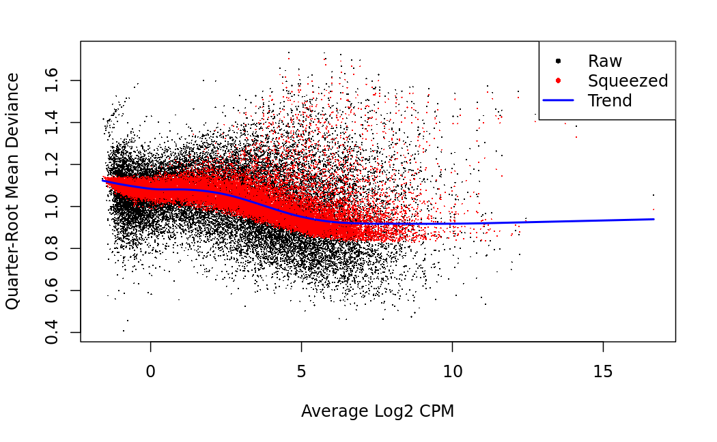
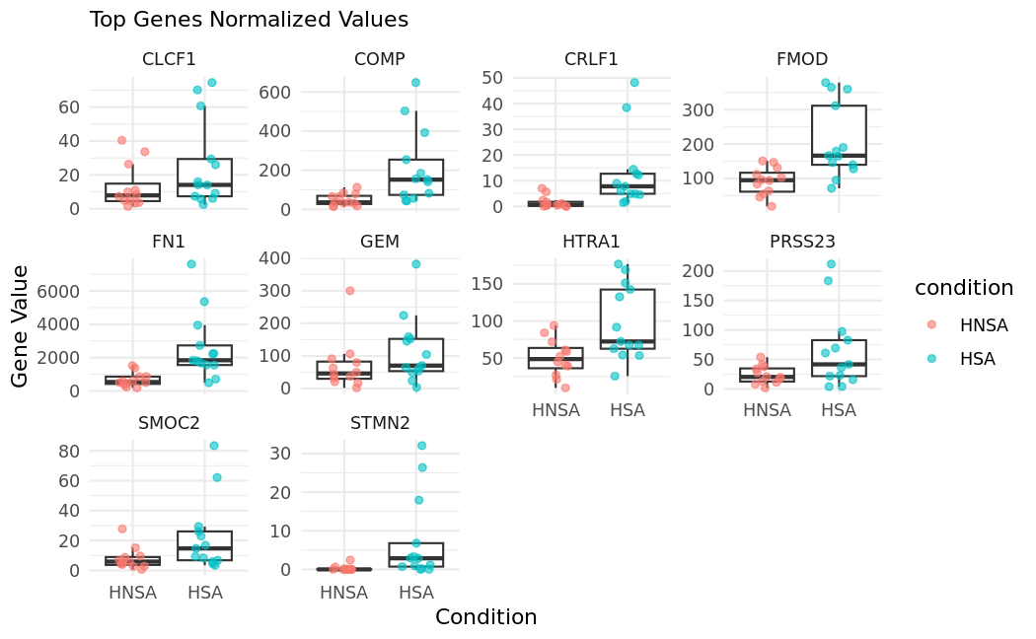
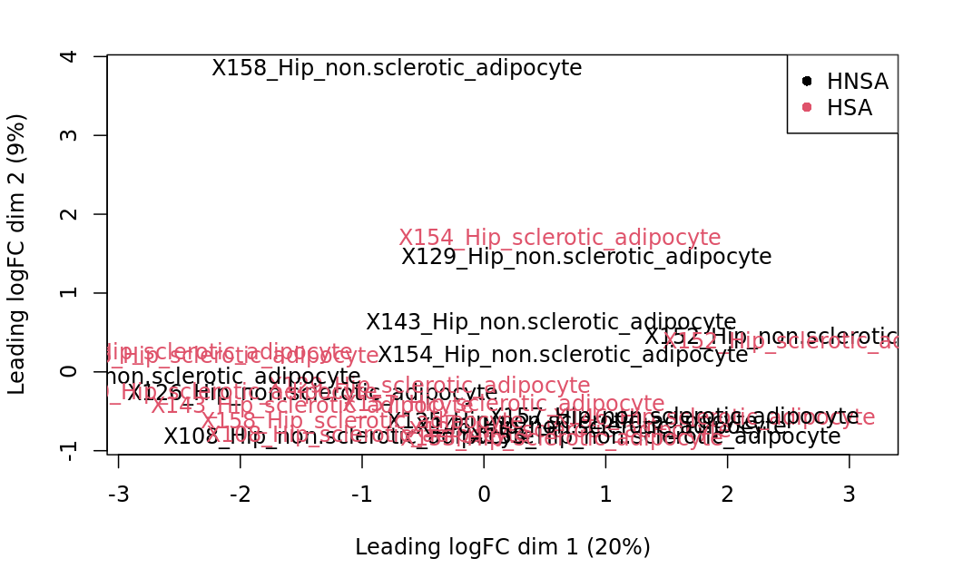
Hip Adipoctytes sclerotic vs non.sclerotic
HSA vs HNSA

Slide 15
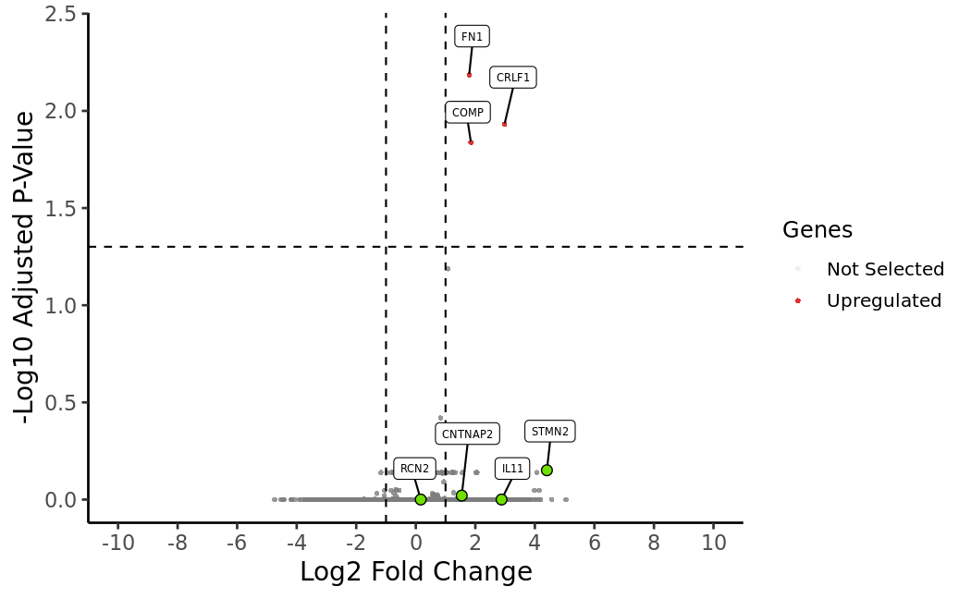
Hip Adipoctytes sclerotic vs non.sclerotic
HSA vs HNSA
Add volcano

Slide 16
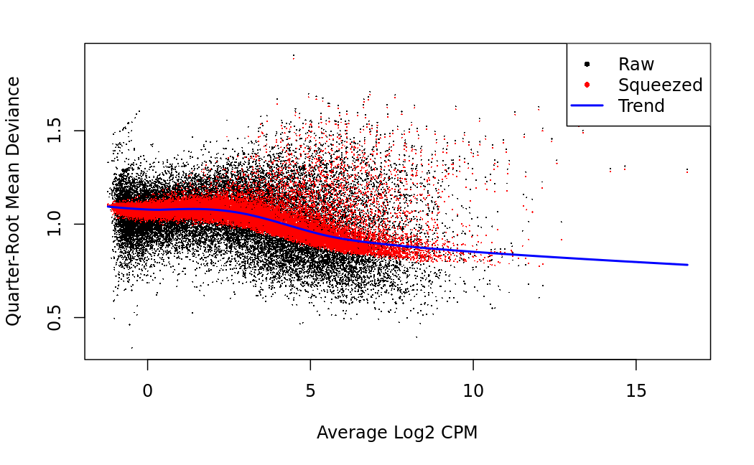
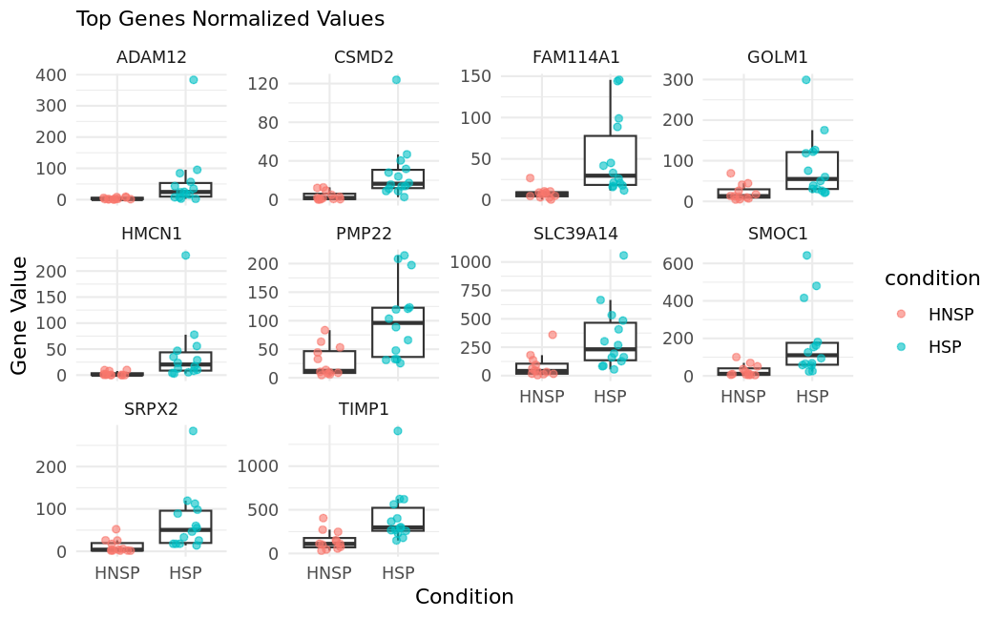
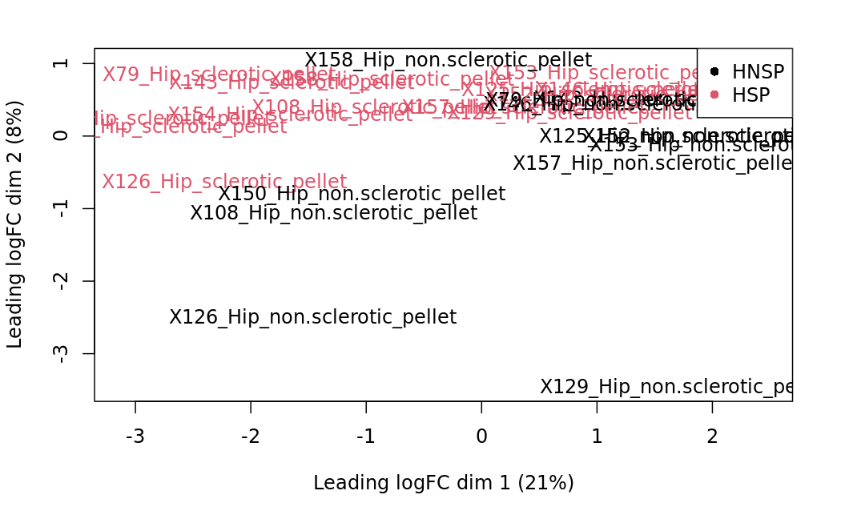
Hip Pellets sclerotic vs non.sclerotic
HSP vs HNSP

Slide 17
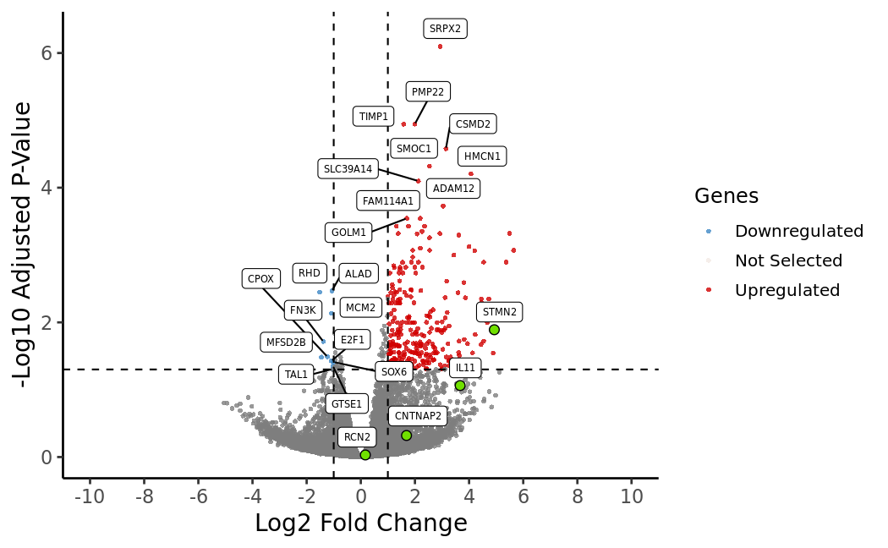
Hip Pellets sclerotic vs non.sclerotic
HSP vs HNSP

Slide 18
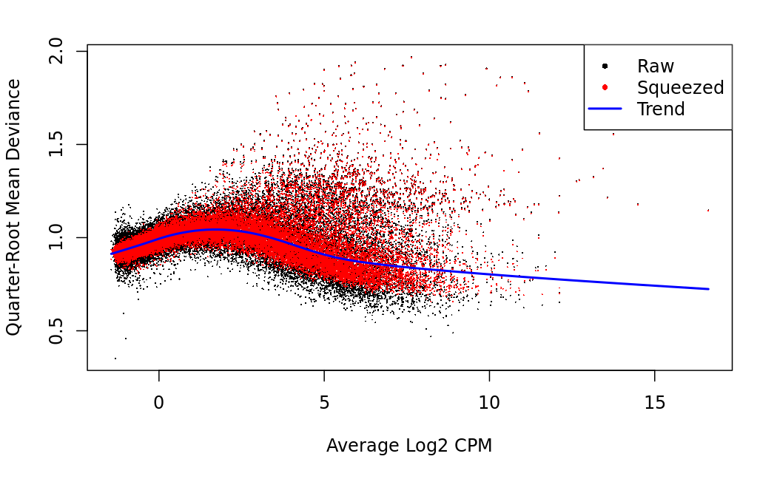
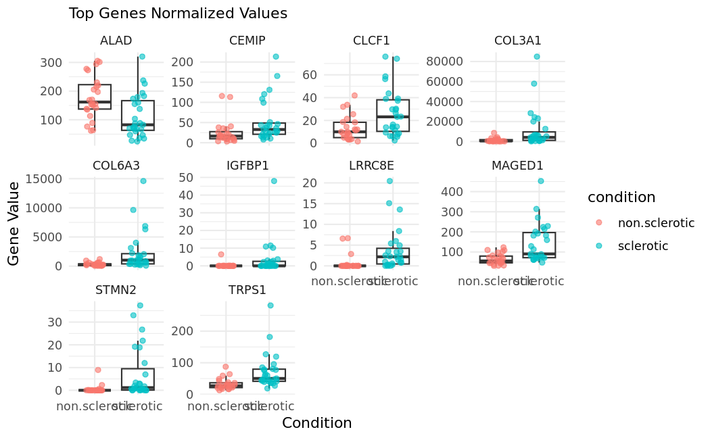
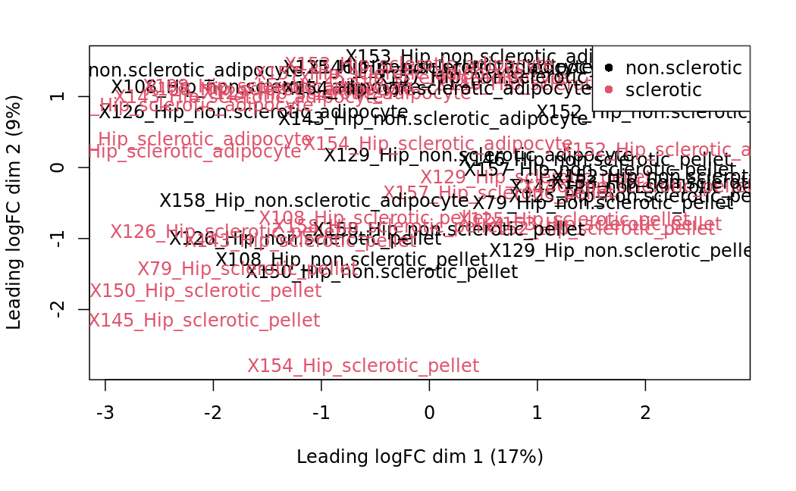
Hip sclerotic vs non.sclerotic
sclerotic vs non.sclerotic

Slide 19
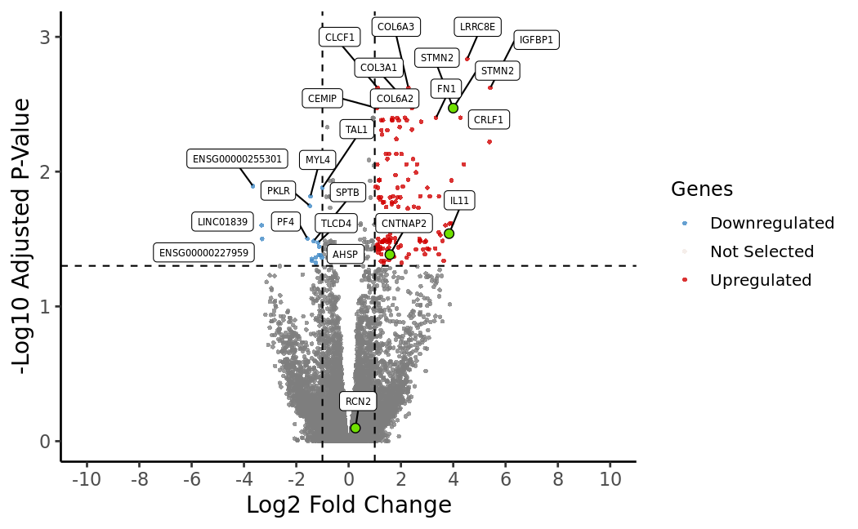
Hip sclerotic vs non.sclerotic
sclerotic vs non.sclerotic

Slide 20
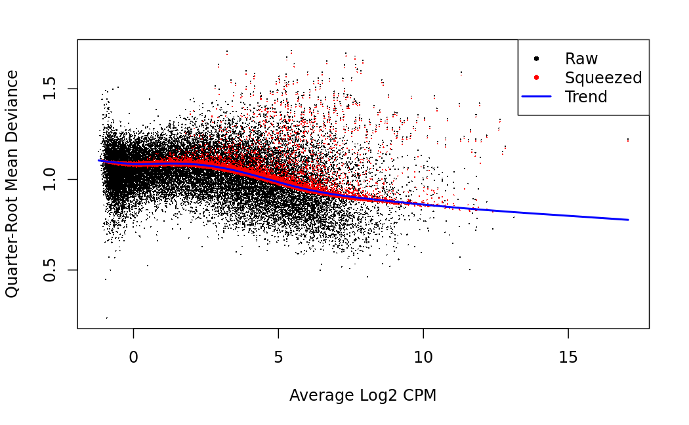
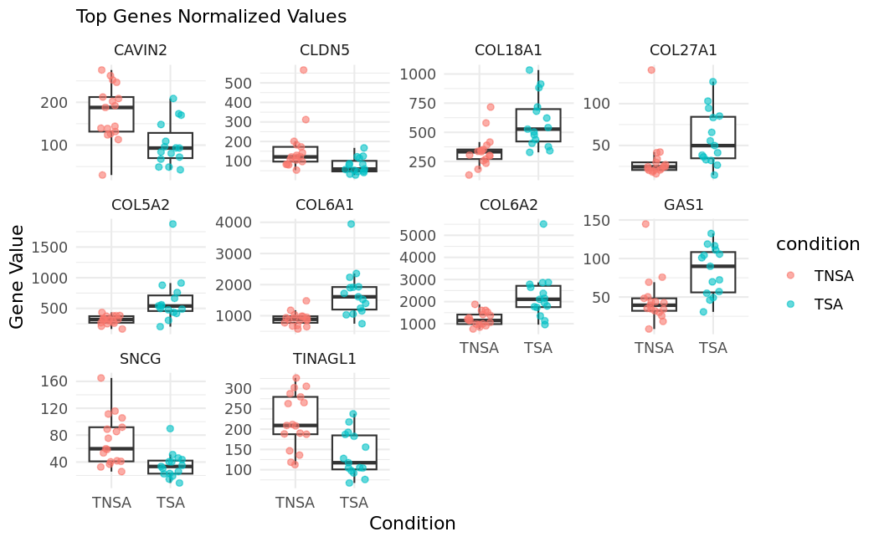
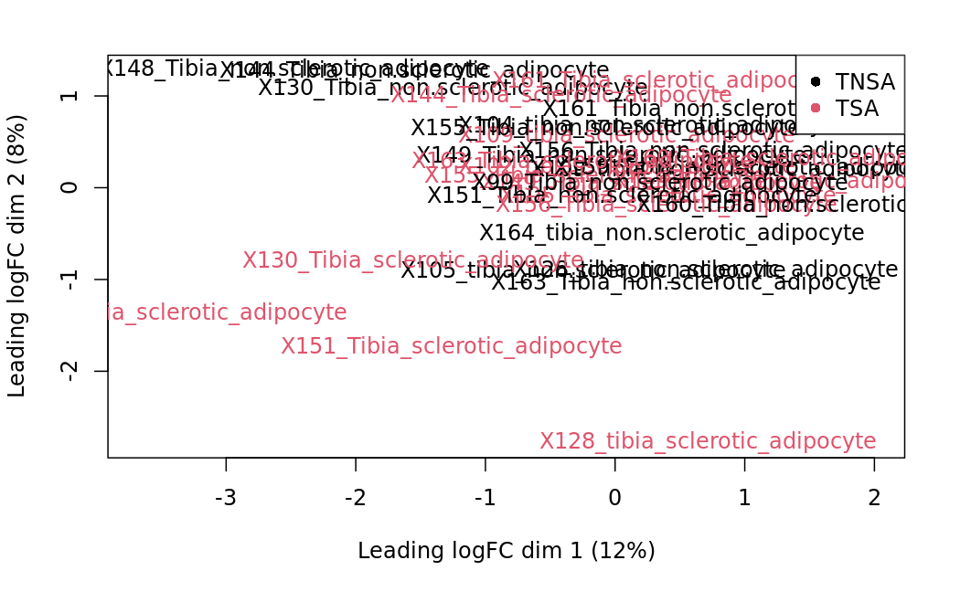
Tibia dipocytes
TSA vs TNSA

Slide 21
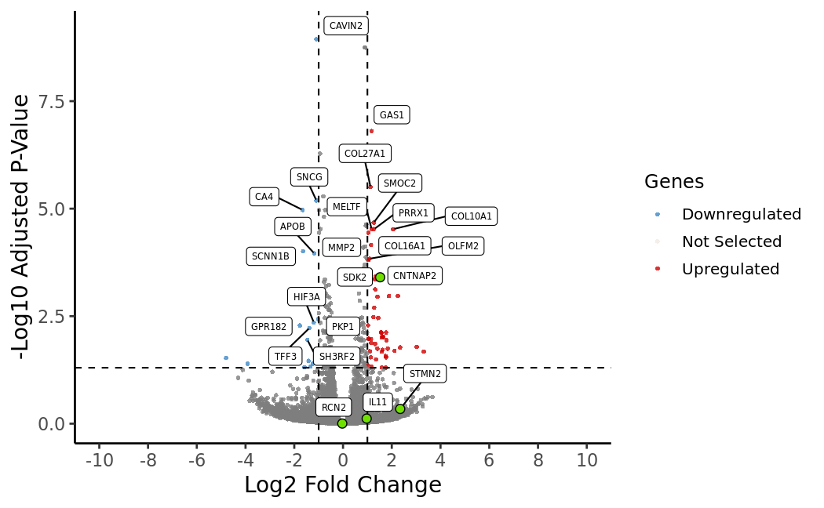
Tibia dipocytes
TSA vs TNSA

Slide 22
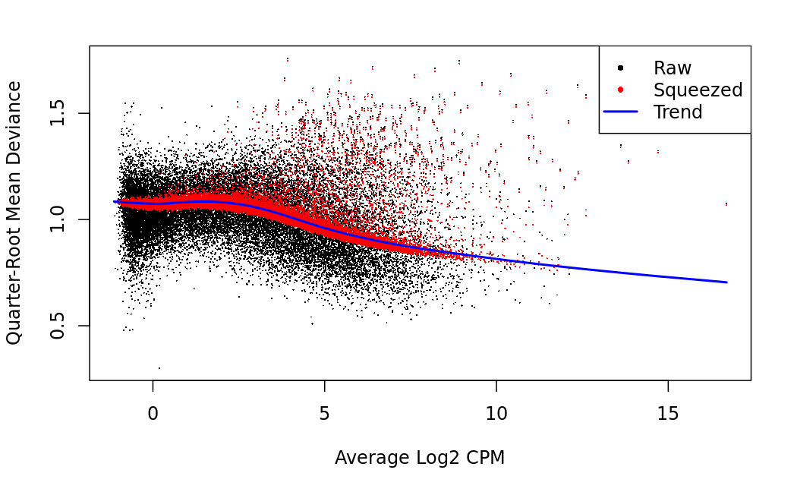
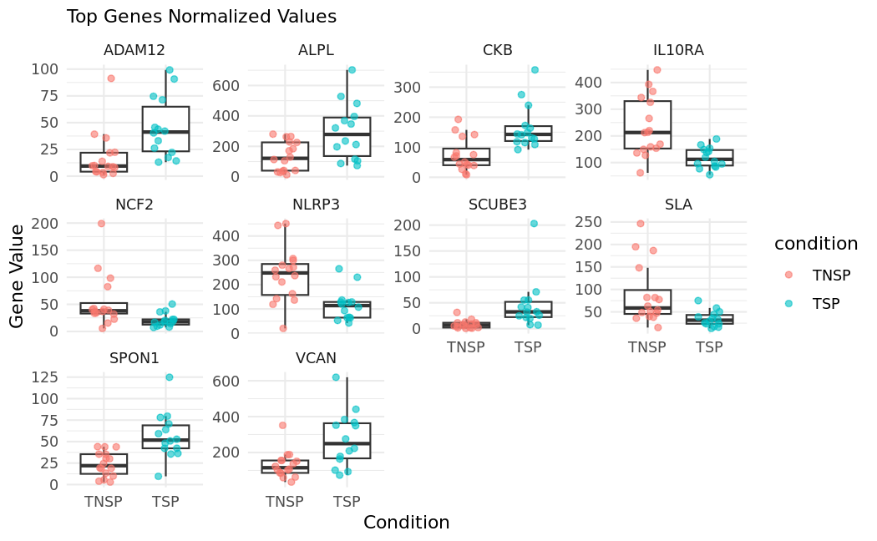
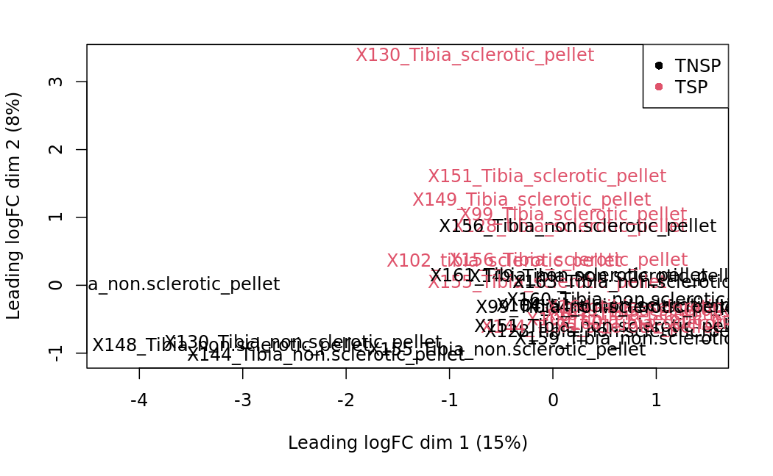
Tibia pellets
TSP vs TNSP

Slide 23
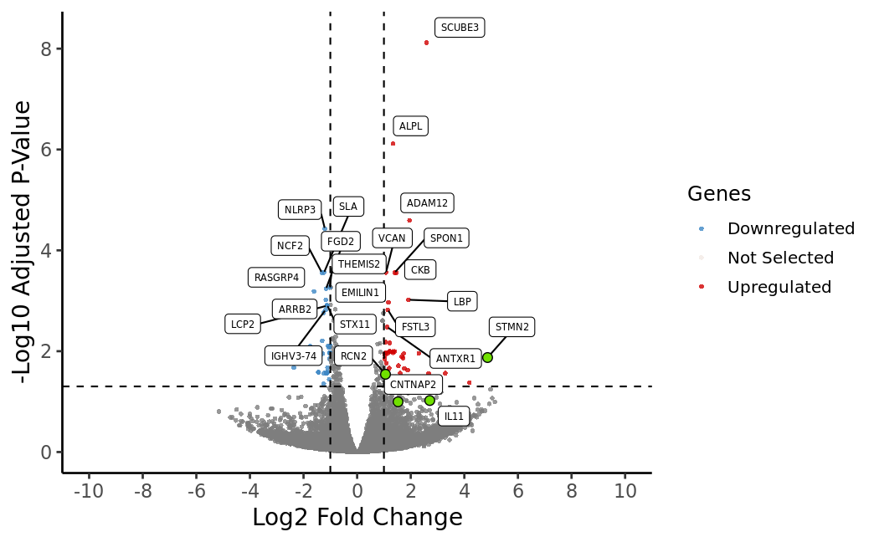
Tibia pellets
TSP vs TNSP

Slide 24
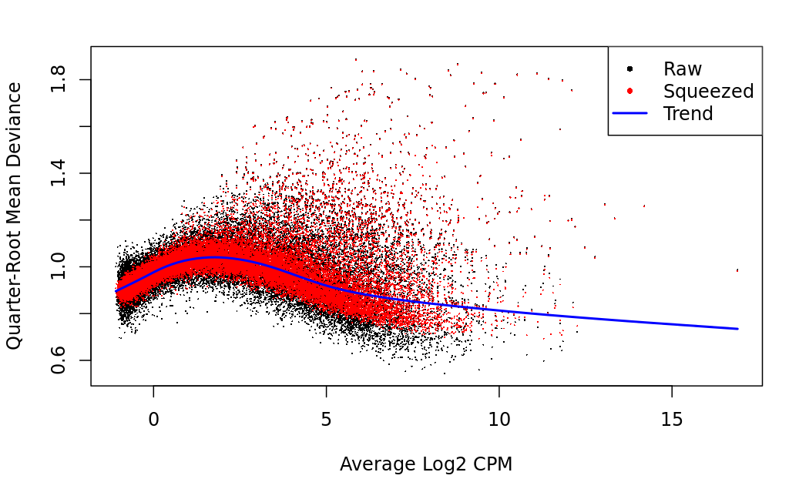
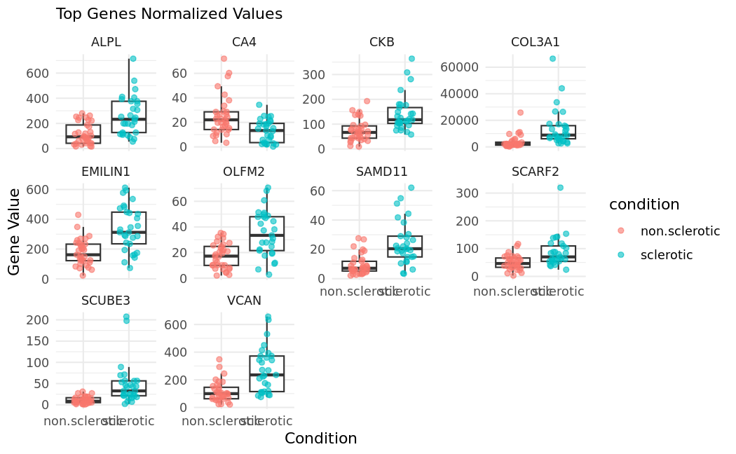
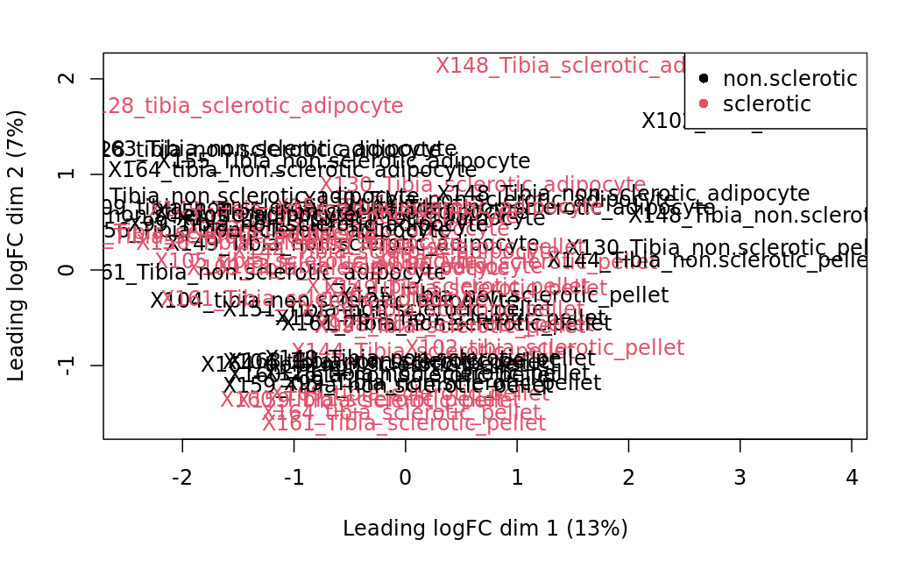
Tibia
Sclerotic vs non.sclerotic

Slide 25
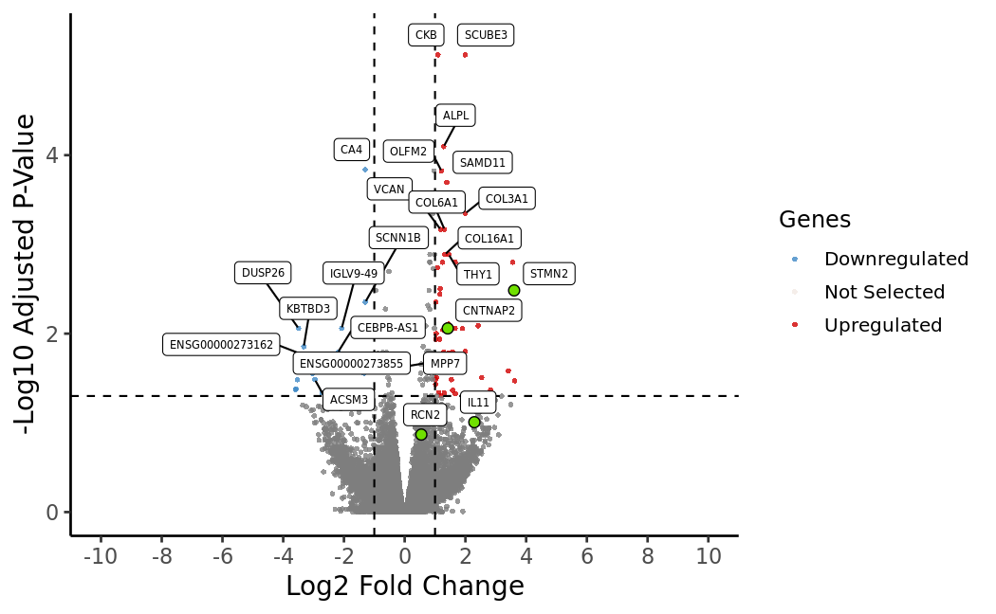
Tibia
Sclerotic vs non.sclerotic

Slide 26
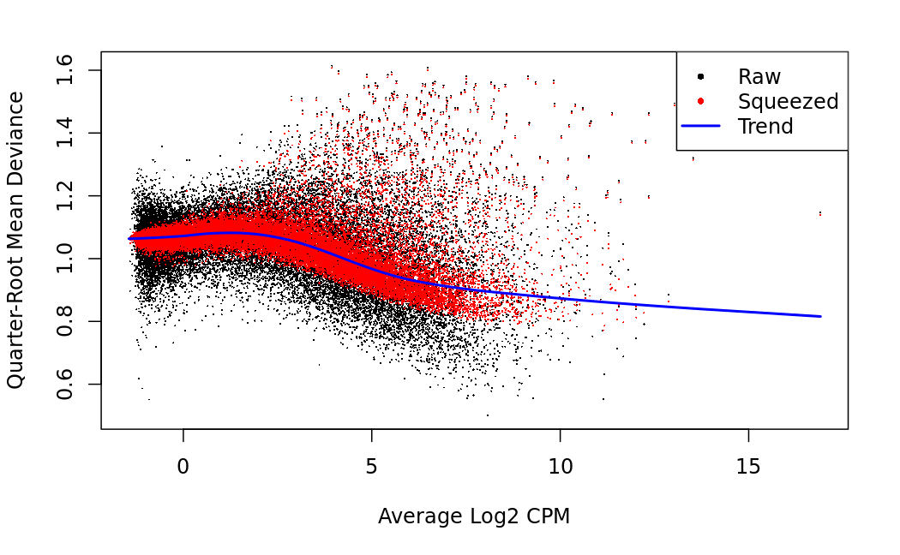
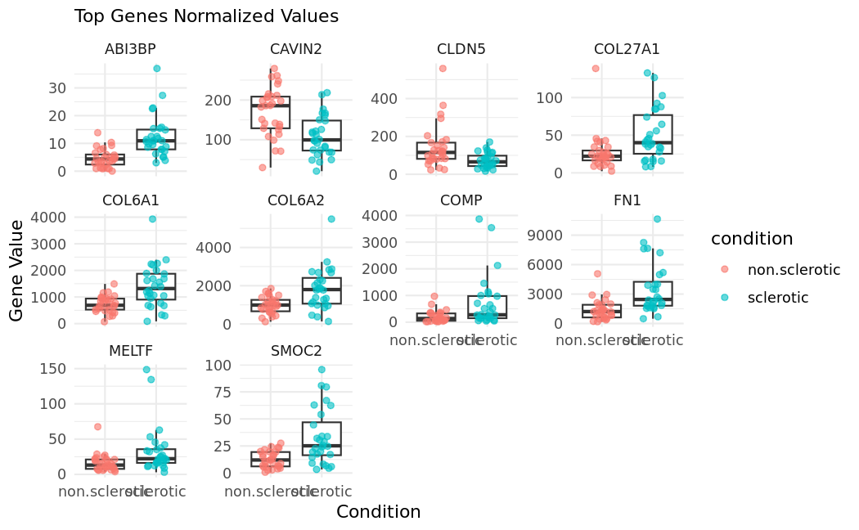
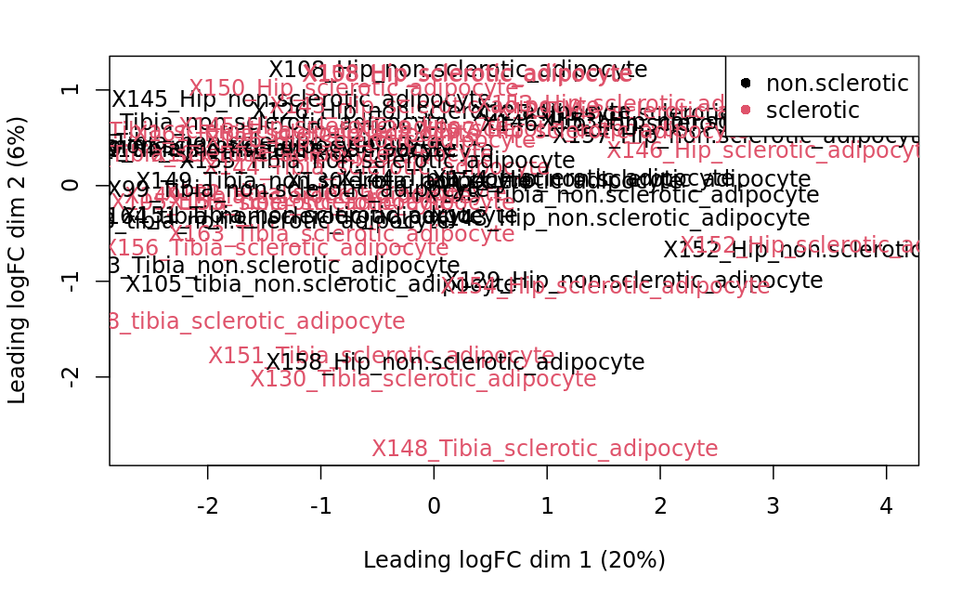
Adipocytes (tibia and hip)
Sclerotic vs non.sclerotic ~patient + condition

Slide 27
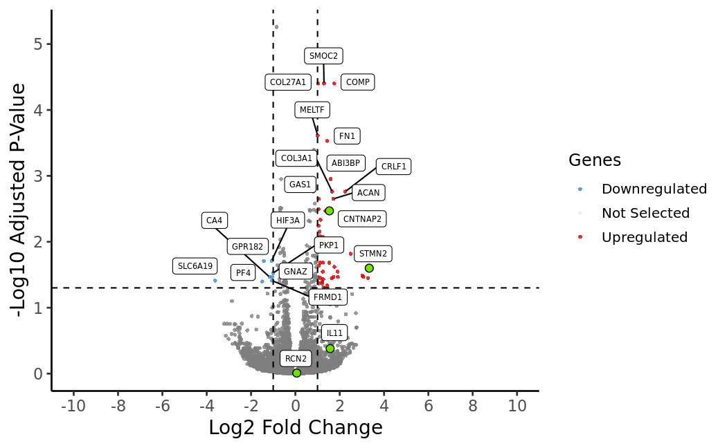
Adipocytes (tibia and hip)
Sclerotic vs non.sclerotic ~patient + condition

Slide 28
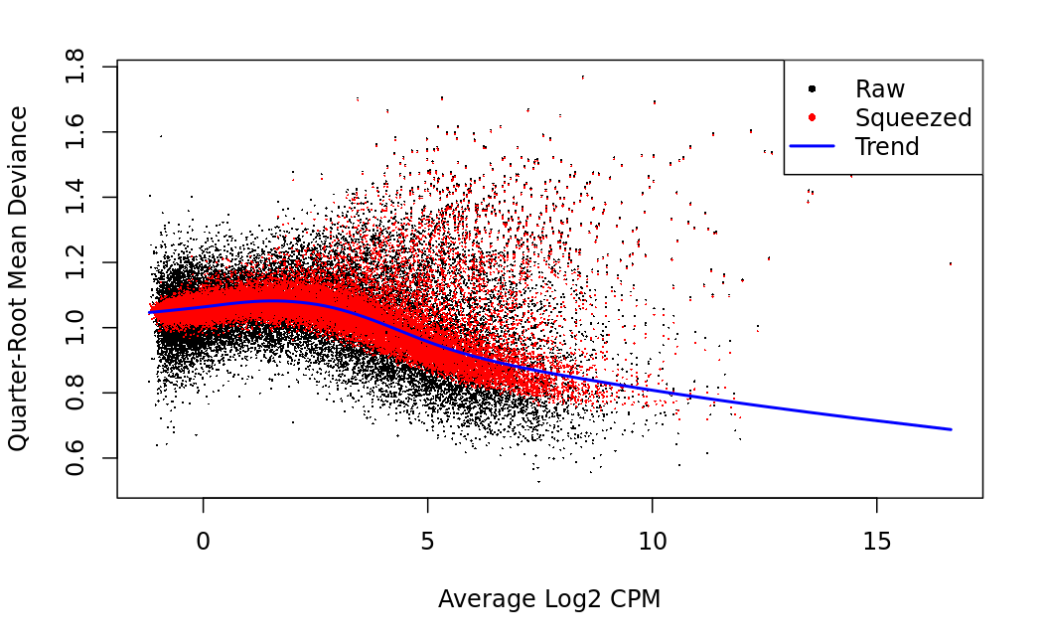
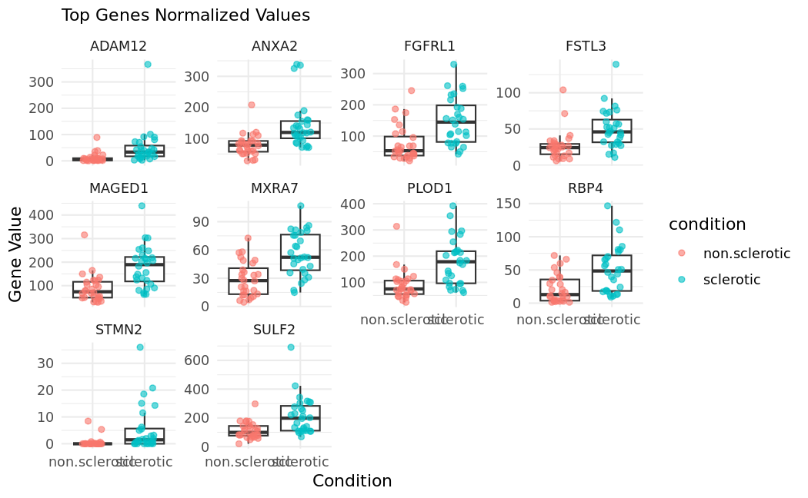
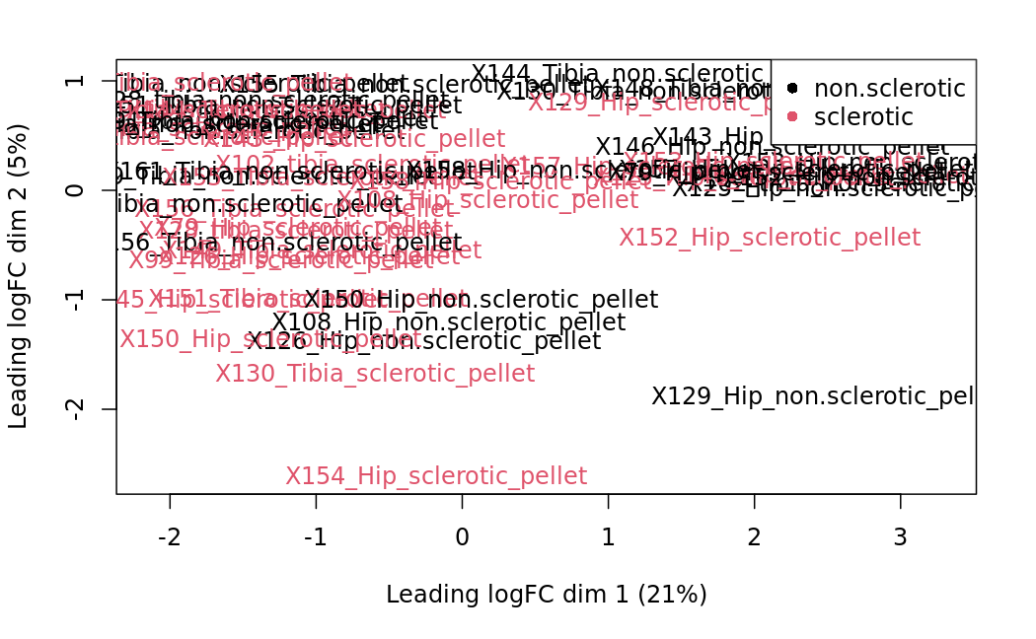
Pellets (tibia and hip)
Sclerotic vs non.sclerotic ~patient + condition

Slide 29
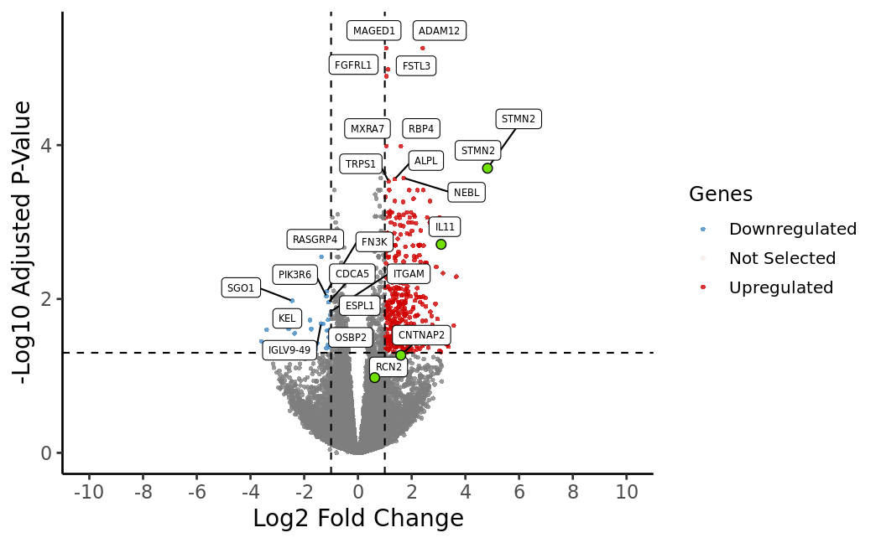
Pellets (tibia and hip)
Sclerotic vs non.sclerotic ~patient + condition

Slide 32
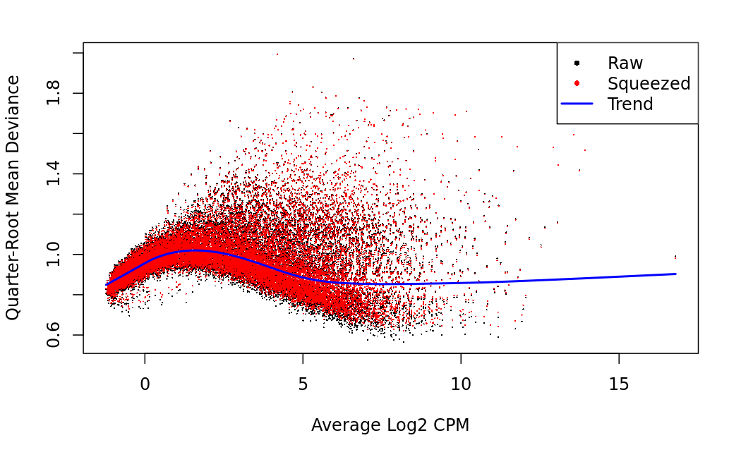
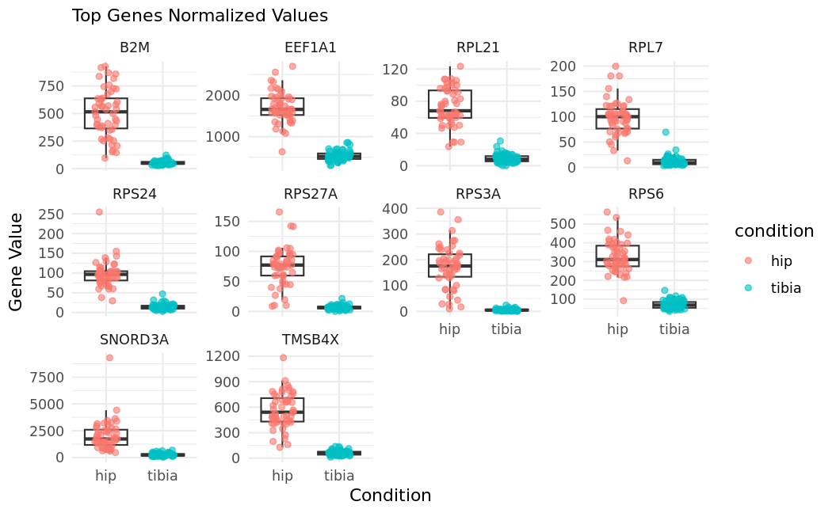
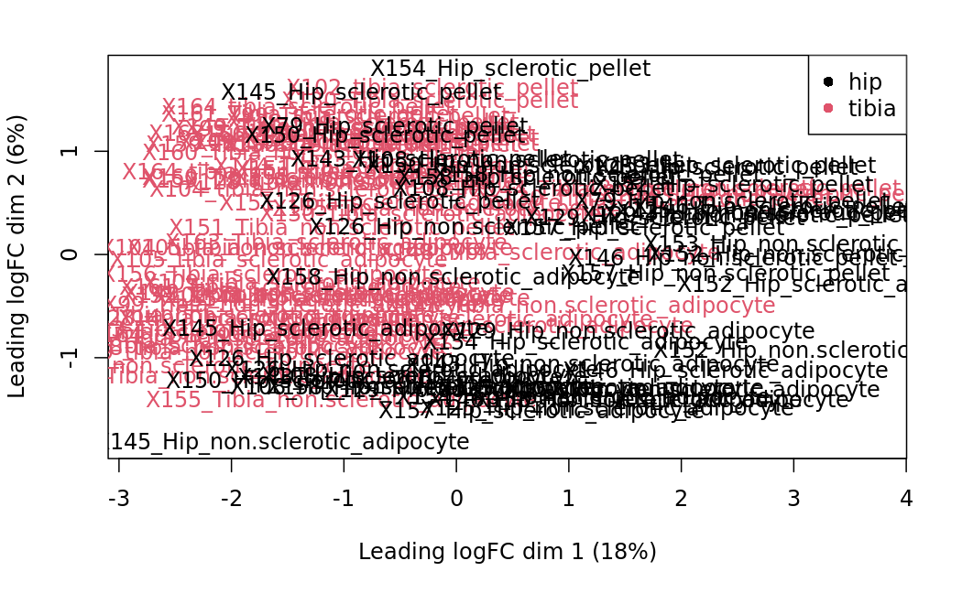
Bone (tibia and hip)
Tibia vs hip(batch=pellet or adipocyte)

Slide 33
Bone (tibia and hip)
Tibia vs hip(batch=pellet or adipocyte)

Slide 34
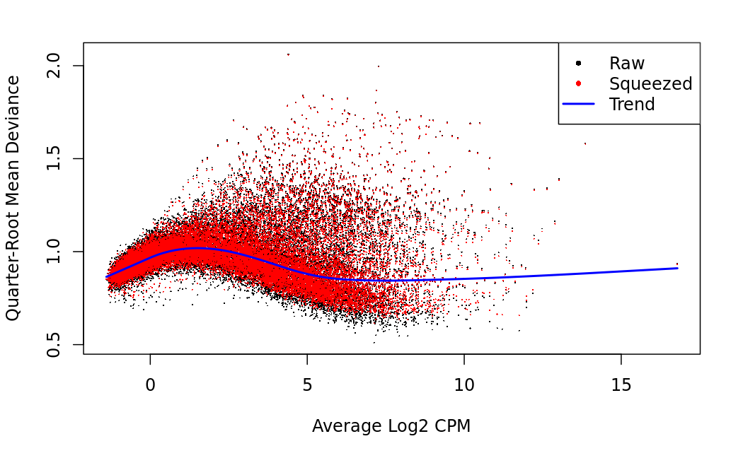
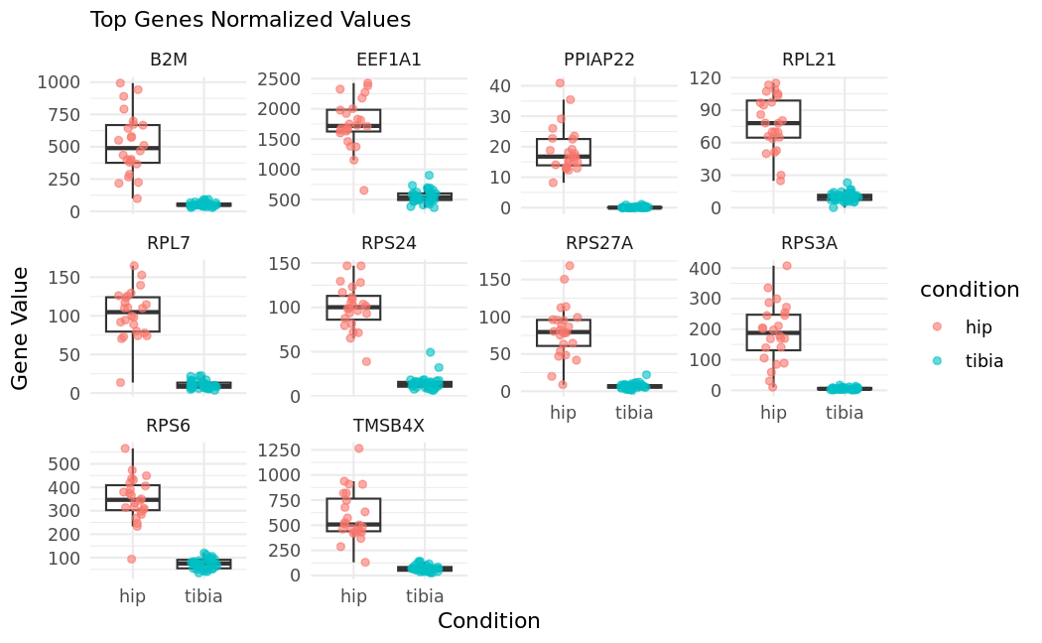
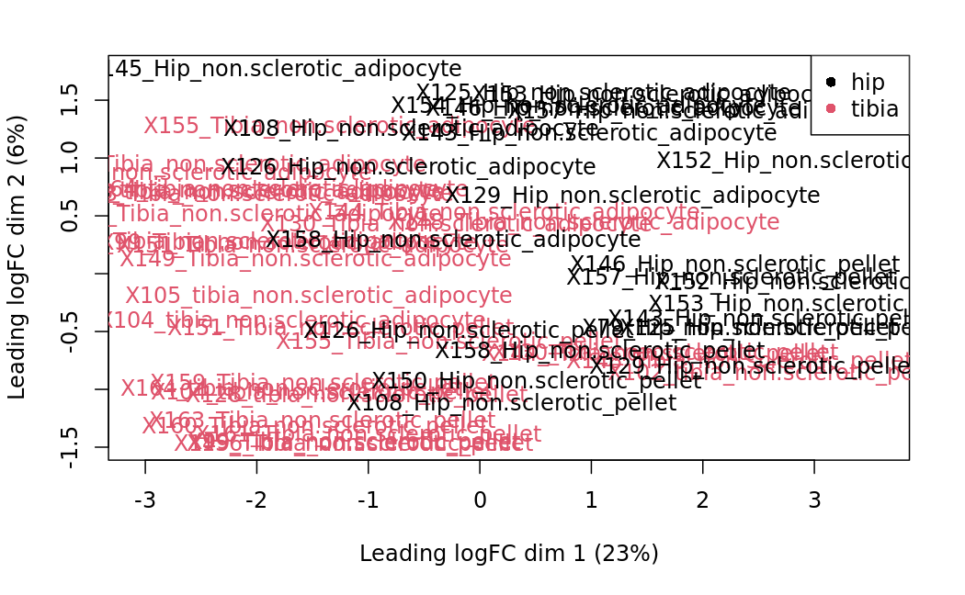
Bone (tibia and hip)
Non.sclerotic Tibia vs hip(batch=pellet or adipocyte)

Slide 35
Bone (tibia and hip)
Non.sclerotic Tibia vs hip(batch=pellet or adipocyte)

Slide 36
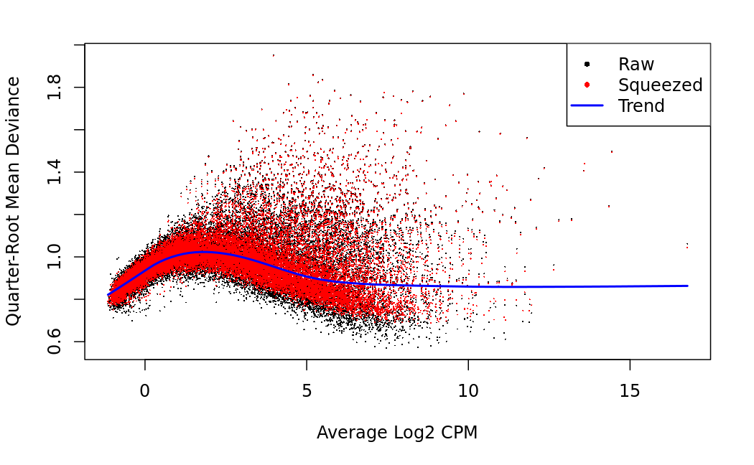
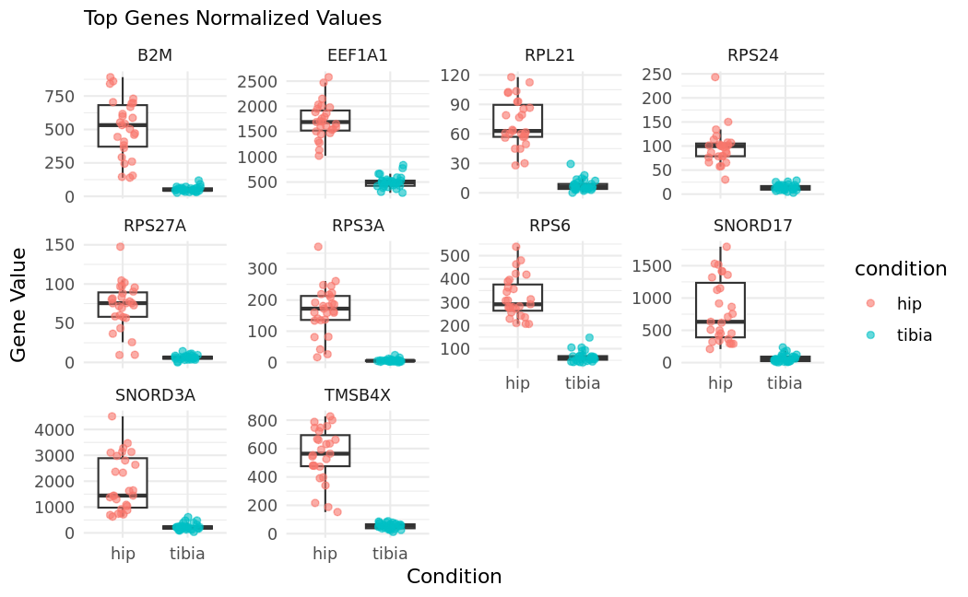
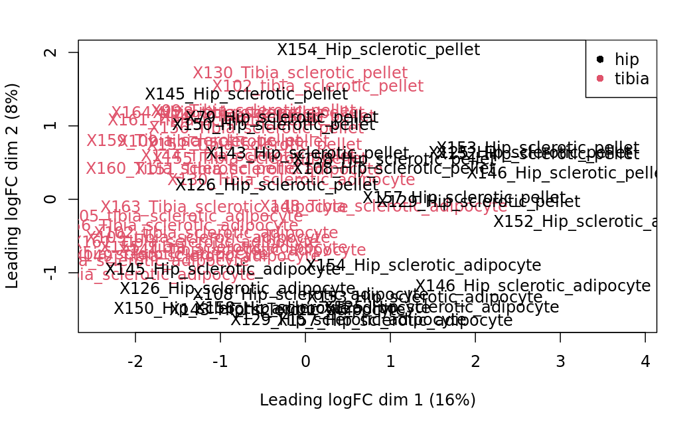
Bone (tibia and hip)
sclerotic Tibia vs hip(batch=pellet or adipocyte)

Slide 37
Bone (tibia and hip)
sclerotic Tibia vs hip(batch=pellet or adipocyte)

Slide 38
Bone (tibia and hip)
sclerotic Tibia vs hip(batch=pellet or adipocyte)

Slide 39
Matrices
Raw counts
Normalized

Slide 40
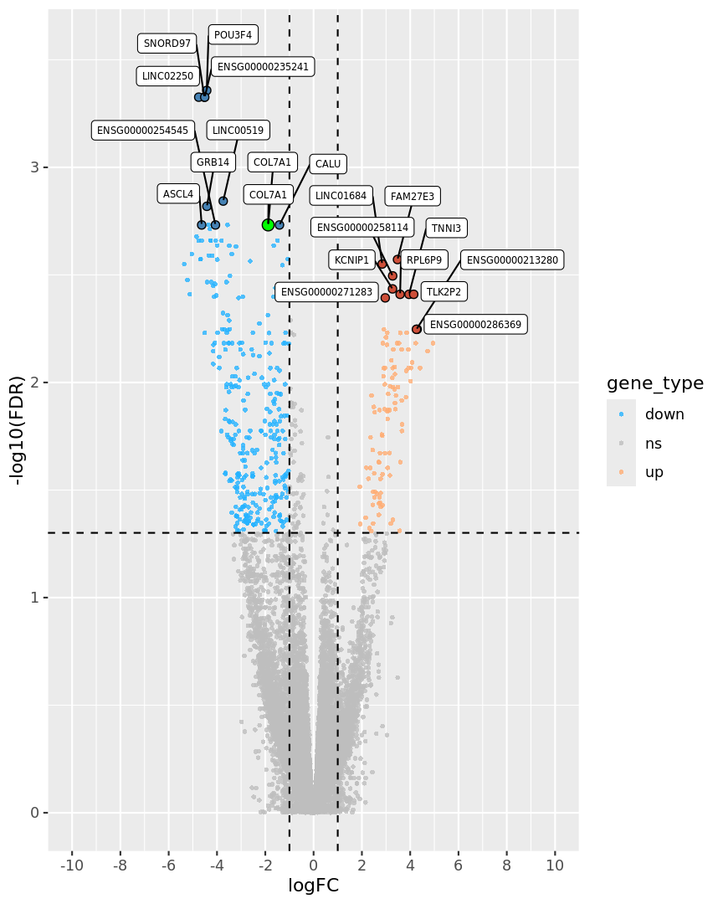
Volcano
Function and graphs

Slide 41
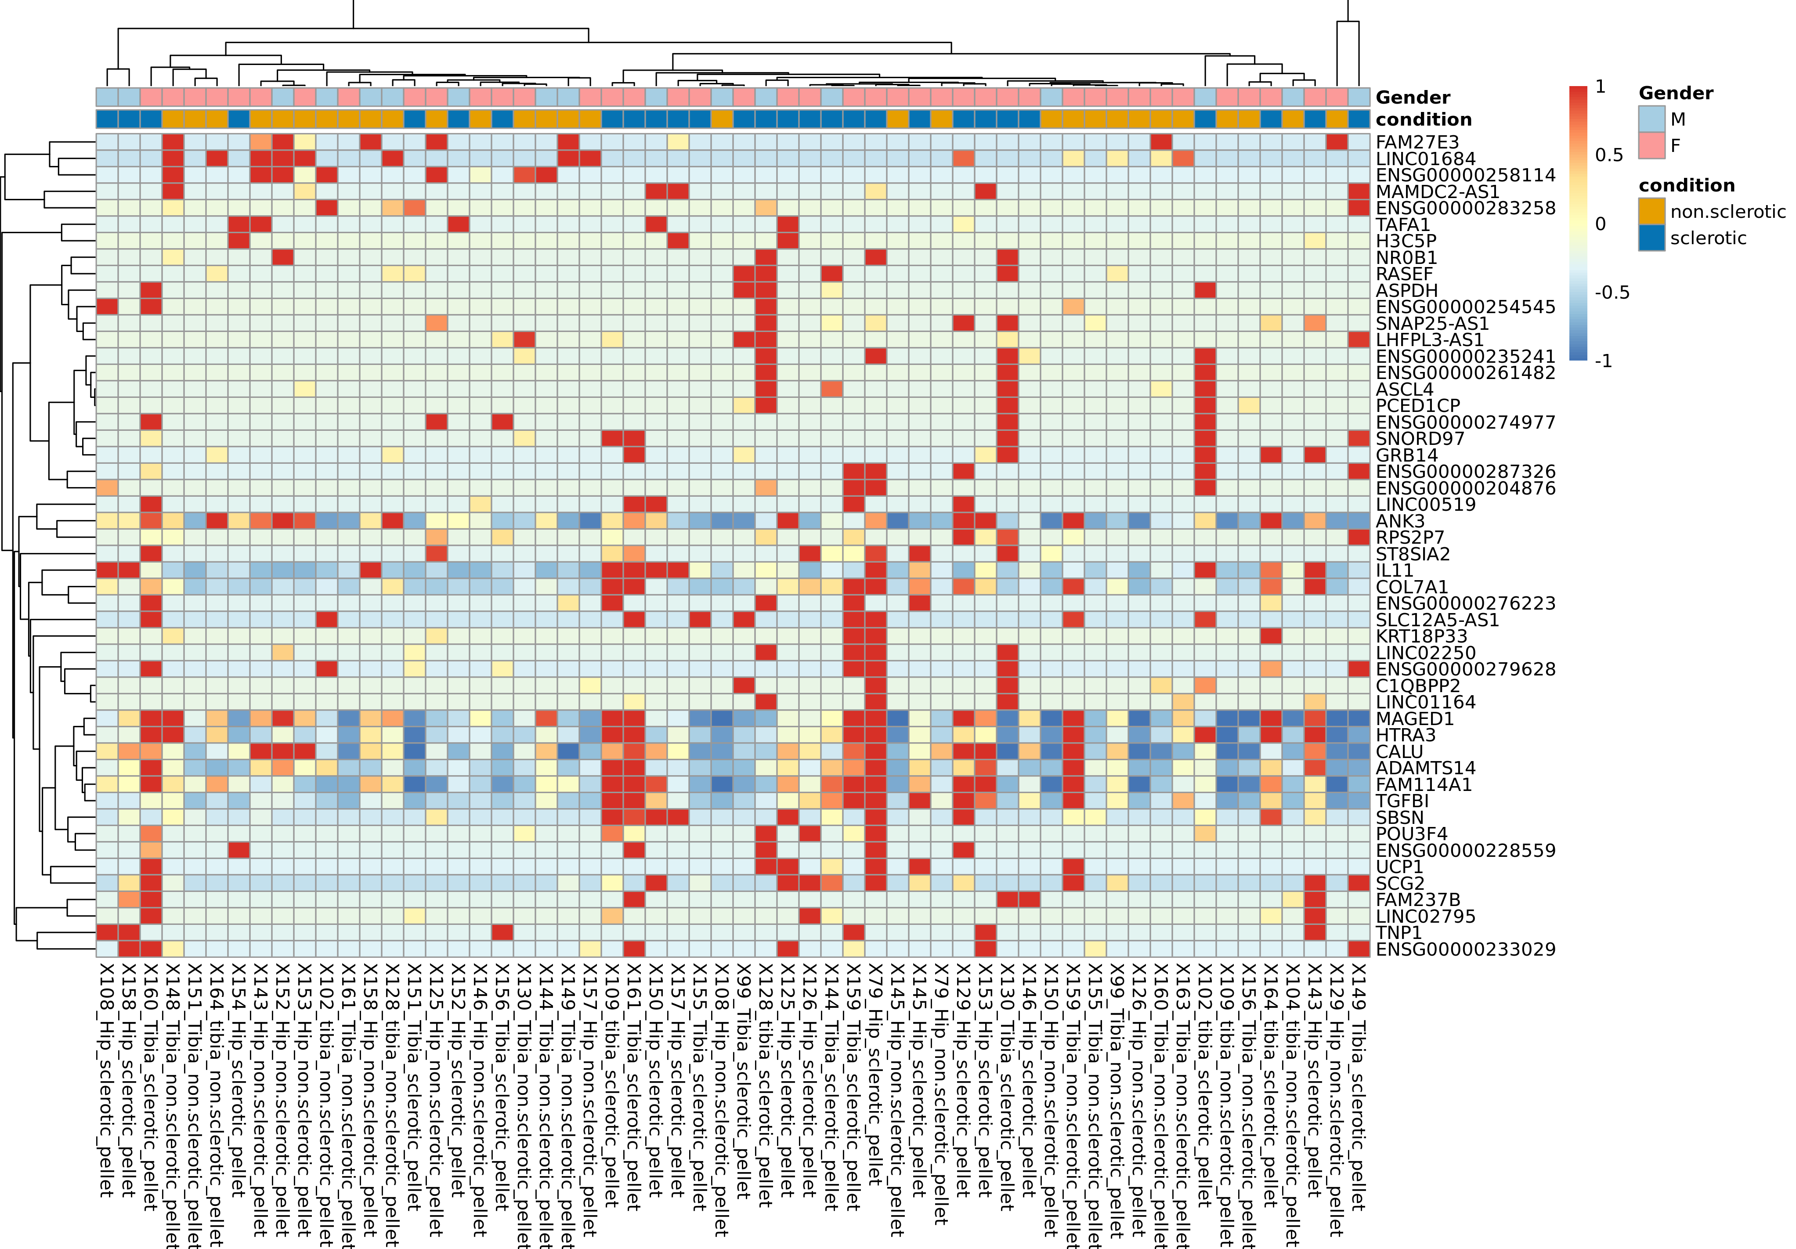
Heatmap
Function and graphs
Raw counts
Comparisson:
pellets_hip_and_tibia_sclerotic_vs_non_sclerotic[[1]]$results$table

Slide 42
Model
Absolutely! Let’s summarize what you want to achieve and then dive into how we can use neural networks for your task.
Objective
You want to build a predictive model using neural networks to classify samples as either sclerotic or non-sclerotic based on gene expression data and metadata. The goal is to train a model that can accurately predict the condition of a sample and understand the features contributing to this prediction.
Data Overview
Gene Expression Data: A matrix where rows represent genes and columns represent samples. Each cell contains the expression level of a gene in a specific sample.
Metadata: Additional information about each sample, such as condition (sclerotic or non-sclerotic), gender, and potentially other factors like age and tissue type.
Steps to Build a Neural Network Model
Data Preparation:
Combine gene expression data and metadata into a single dataframe.
Normalize or scale the gene expression data.
Encode categorical variables (e.g., condition, gender) as numerical values.
Data Splitting:
Split the data into training and testing sets.
Model Building:
Define a neural network architecture suitable for classification.
Compile the model with appropriate loss function and optimizer.
Model Training:
Train the model on the training data.
Model Evaluation:
Evaluate the model’s performance on the testing data using metrics such as accuracy, precision, recall, F1-score, and ROC-AUC.
Model Interpretation:
Analyze the model to understand which features are most predictive of the condition.
Example Code Using Keras in R
Here’s an example of how you might implement this using the keras package in R:
library(keras) library(dplyr) library(caret) # Combine gene expression data and metadata combined_data <- cbind(raw_counts, annotation_col) # Ensure the condition column is a factor combined_data$condition <- as.factor(combined_data$condition) # Encode categorical variables combined_data$condition <- as.numeric(combined_data$condition) - 1 combined_data$Gender <- as.numeric(as.factor(combined_data$Gender)) - 1 # Normalize gene expression data gene_data <- as.matrix(combined_data[, 1:ncol(raw_counts)]) gene_data <- scale(gene_data) # Combine normalized gene data with metadata combined_data <- cbind(gene_data, combined_data[, (ncol(raw_counts) + 1):ncol(combined_data)]) # Split the data into training and testing sets set.seed(123) # For reproducibility trainIndex <- createDataPartition(combined_data$condition, p = .7, list = FALSE, times = 1) train_data <- combined_data[trainIndex, ] test_data <- combined_data[-trainIndex, ] # Separate features and labels x_train <- as.matrix(train_data[, -ncol(train_data)]) y_train <- train_data$condition x_test <- as.matrix(test_data[, -ncol(test_data)]) y_test <- test_data$condition # Define the neural network model model <- keras_model_sequential() %>% layer_dense(units = 128, activation = 'relu', input_shape = ncol(x_train)) %>% layer_dropout(rate = 0.4) %>% layer_dense(units = 64, activation = 'relu') %>% layer_dropout(rate = 0.3) %>% layer_dense(units = 1, activation = 'sigmoid') # Compile the model model %>% compile( loss = 'binary_crossentropy', optimizer = optimizer_adam(), metrics = c('accuracy') ) # Train the model history <- model %>% fit( x_train, y_train, epochs = 50, batch_size = 32, validation_split = 0.2 ) # Evaluate the model model %>% evaluate(x_test, y_test) # Predict on the test data predictions <- model %>% predict_classes(x_test) # Confusion matrix confusionMatrix(as.factor(predictions), as.factor(y_test))
Explanation:
Data Preparation: Combines and normalizes the data, encodes categorical variables.
Data Splitting: Splits the data into training and testing sets.
Model Building: Defines a neural network architecture.
Model Training: Trains the model on the training data.
Model Evaluation: Evaluates the model’s performance on the test data.
This should give you a solid starting point for using neural networks to predict the condition of your samples. If you have any more questions or need further assistance, feel free to ask!

